Slide 1
BIT 2203: ADVANCED Programming Lecture 5: Graphical User Interfaces
Dr. Onyango Okeyo

Slide 2
Elements of GUI Programming
Components
Visual objects that appear on the screen
Layouts
Control over the positioning of components within a container
Events
Responses to user actions
Graphics
Lines, shapes, colors, fonts, etc.
All are encapsulated in Java Classes and Packages

Slide 3
Components
Two categories of Java Component classes:
AWT – Abstract Windows Toolkit (java.awt package)
The older version of the components
Rely on “peer architecture”…drawing done by the OS platform on which the application/applet is running
Considered to be “heavy-weight”
Swing (javax.swing package)
Newer version of the components
No “peer architecture”…components draw themselves
Most are consdered to be “lightweight”

Slide 4
GUI Class Hierarchy (AWT)

Slide 5
GUI Class Hierarchy (Swing)

Slide 6
Container Classes
Container classes can contain other GUI components.

Slide 7
GUI Helper Classes
The helper classes are not subclasses of Component. They are used to describe the properties of GUI components such as graphics context, colors, fonts, and dimension.

Slide 8
Swing GUI Components

Slide 9
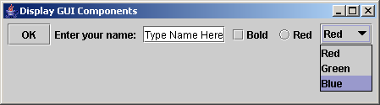
Creating GUI Objects
// Create a button with text OK
JButton jbtOK = new JButton("OK");
// Create a label with text "Enter your name: "
JLabel jlblName = new JLabel("Enter your name: ");
// Create a text field with text "Type Name Here"
JTextField jtfName = new JTextField("Type Name Here");
// Create a check box with text bold
JCheckBox jchkBold = new JCheckBox("Bold");
// Create a radio button with text red
JRadioButton jrbRed = new JRadioButton("Red");
// Create a combo box with choices red, green, and blue
JComboBox jcboColor = new JComboBox(new String[]{"Red",
"Green", "Blue"});
Label
Text field
Check Box
Radio Button
Button
Combo Box

Slide 10
Frames
Frame is a window that is not contained inside another window.
Frame is the basis to contain other user interface components in Java graphical applications.
The Frame class can be used to create windows.

Slide 11
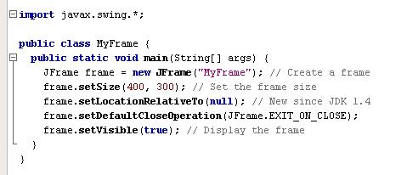
Code Listing
Any use of Swing classes requires importing javax.swing package.
Instantiate a swing Frame object
Call JFrame methods to control visuals and behavior

Slide 12
Code Listing
Set width and height of the frame in pixels

Slide 13
Code Listing
Cause frame to be centered on the screen when displayed

Slide 14
Code Listing
When user closes the window, the application will terminate

Slide 15
Code Listing
This is needed to make the frame actually show up on the screen

Slide 16
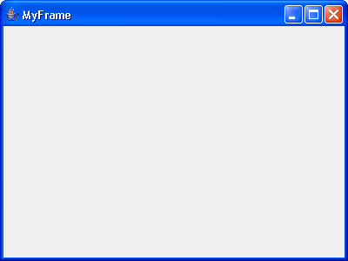
This is what a frame looks like.
Note the title bar, the content area, the minimize, maximize/restore, and close icons.
Caption in the title bar was determined from the argument to the constructor.

Slide 17
Frames with Components
A Frame is a container. Therefore it can contain other components (like buttons, text fields, etc.)
Components are added to the content pane of a frame.
The content pane is the grey area in the Frame window.
A simplistic way to look at containment is this:
A JFrame contains:
A menu bar
A content pane

Slide 18
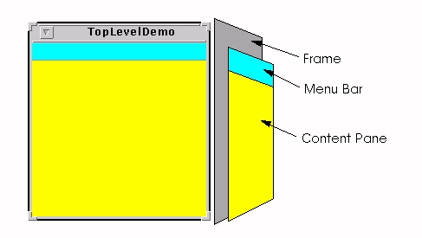
A Picture of Frame Containment
Actually, there’s more to it than this,
but this picture will suffice for now.

Slide 19
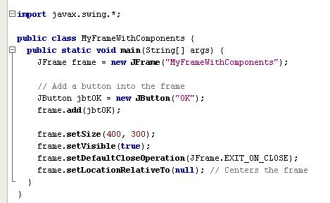
Code Listing
Example: adding a component to the content pane of a Frame

Slide 20
1) Declare a reference variable for a button object.
2) Instantiate a button
Note: prior to Java 1.5, you needed to call getContentPane() in order to obtain the frame’s content pane.
This is no longer necessary.
3) Add the button to the content pane of the frame.

Slide 21
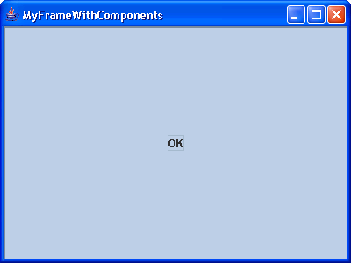
Resulting Screen
Here is the button

Slide 22
Layout Managers
Control the placement of components on the container.
This is an alternative to hardcoding the pixel locations of the components.
Advantage: resizing the container (frame) will not occlude or distort the view of the components.
Main layout managers:
FlowLayout, GridLayout, BorderLayout, CardLayout, and GridBagLayout

Slide 23
Layout Manager Hierarchy
LayoutManager is an interface. All the layout classes implement this interface

Slide 24
FlowLayout
Places components sequentially (left-to-right) in the order they were added
Components will wrap around if the width of the container is not wide enough to hold them all in a row.
Default for applets and panels, but not for frames
Options:
left, center (this is the default), or right
Typical syntax: in your Frame class’s constructor
setLayout(new FlowLayout(FlowLayout.LEFT)) OR
setLayout(new FlowLayout(FlowLayout.LEFT,hgap,vgap))

Slide 25
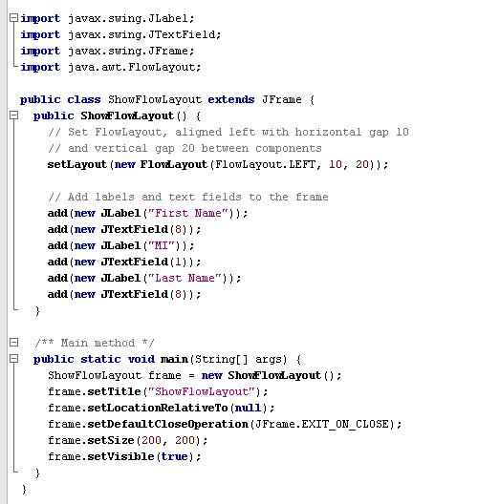
Code Listing : A Frame class that uses FlowLayout layout manager

Slide 26
Code Listing : A Frame class that uses FlowLayout layout manager
Note: creating a subclass of JFrame

Slide 27
Code Listing : A Frame class that uses FlowLayout layout manager
Note: it’s common to make the Frame an application class by including a main method. The main method will instantiate its own class.

Slide 28
Code Listing : A Frame class that uses FlowLayout layout manager
Swing components are in java.swing package
Layout managers are in java.awt package
1
2
The constructor will typically do the following:
Set the layout manager for the frame’s content pane
Add the components to the frame’s content pane
In this case, the layout is Flow, and 6 Swing components are added

Slide 29
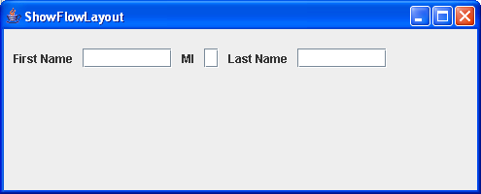
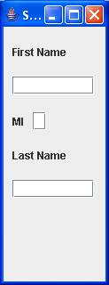
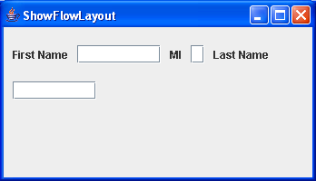
Resizing the frame causes the components to wrap around when necessary.

Slide 30
GridLayout
Arranges components into rows and columns
In Frame’s constructor:
setLayout
(new GridLayout(rows,columns))
OR
setLayout(new GridLayout(rows,columns,hgap,vgap))
Components will be added in order, left to right, row by row
Components will be equal in size
As container is resized, components will resize accordingly, and remain in same grid arrangement

Slide 31
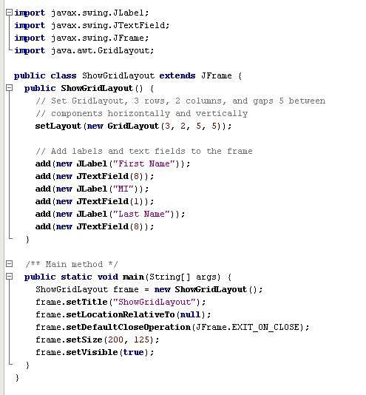
Code Listing : A Frame class that uses GridLayout layout manager
Setting the layout manager
Adding components

Slide 32
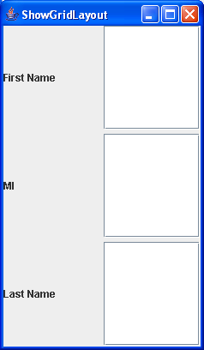
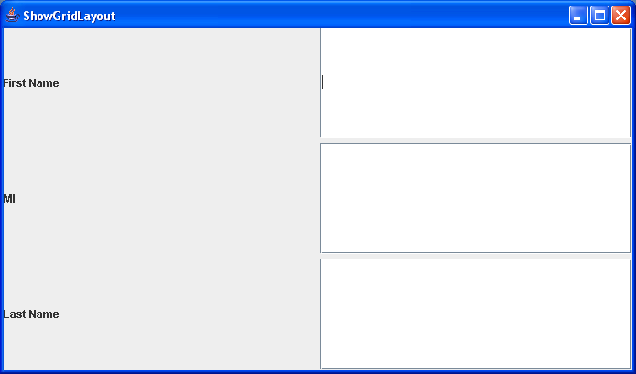
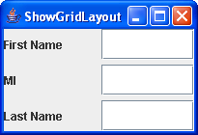
Resizing the frame causes the components to resize and maintain their same grid pattern.

Slide 33
BorderLayout
Arranges components into five areas: North, South, East, West, and Center
In the constructor:
setLayout(new BorderLayout())
OR
setLayout(new BorderLayout(hgap,vgap))
for each component:
add (the_component, region)
do for each area desired:
BorderLayout.EAST, BorderLayout.SOUTH, BorderLayout.WEST, BorderLayout.NORTH, or BorderLayout.CENTER
Behavior: when the container is resized, the components will be resized but remain in the same locations.
NOTE: only a maximum of five components can be added and seen in this case, one to each region.

Slide 34
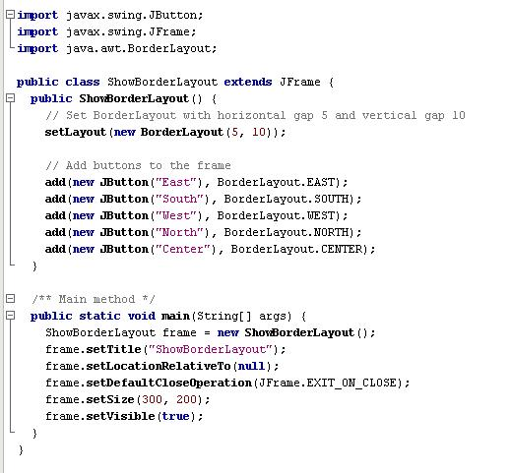
Code Listing : A Frame class that uses BorderLayout layout manager
Setting the layout manager
Adding components to specific regions

Slide 35
Resizing the frame causes the components to resize and maintain their same regions.
NOTE: the CENTER region dominates the sizing.

Slide 36
Using Panels as “Sub-Containers”
JPanel is a class of special components that can contain other components.
As containers, JPanels can have their own layout managers.
This way, you can combine layouts within the same frame by adding panels to the frame and by adding other components to the panels.
Therefore, like JFrames, you can use these methods with JPanels:
add() – to add components to the panel
setLayout() – to associate a layout manager for the panel

Slide 37
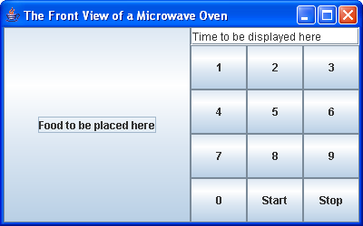
Testing Panels
This example uses panels to organize components. The program creates a user interface for a Microwave oven.

Slide 38
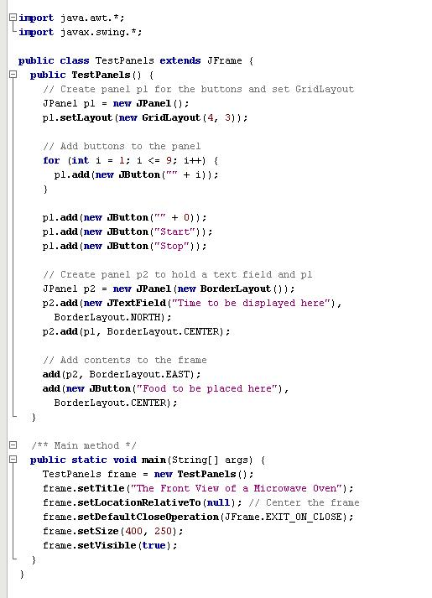
Code Listing :
A Frame class that contains panels for organizing components

Slide 39
Code Listing :
A Frame class that contains panels for organizing components
Creating a panel and setting its layout

Slide 40
Code Listing :
A Frame class that contains panels for organizing components
Adding components to the panel

Slide 41
Code Listing :
A Frame class that contains panels for organizing components
Creating another panel and setting its layout…note that this setting layout for the panel can be done using an overloaded constructor

Slide 42
Code Listing :
A Frame class that contains panels for organizing components
Adding components to the second panel…
NOTE: panel p1 is embedded inside panel p2!

Slide 43
Code Listing :
A Frame class that contains panels for organizing components
Adding a panel and a button to the frame’s content pane.
Note: the JFrame class’s default layout manager is Border, so you if you don’t explicitly call setLayout() for the frame it will be Border.

Slide 44
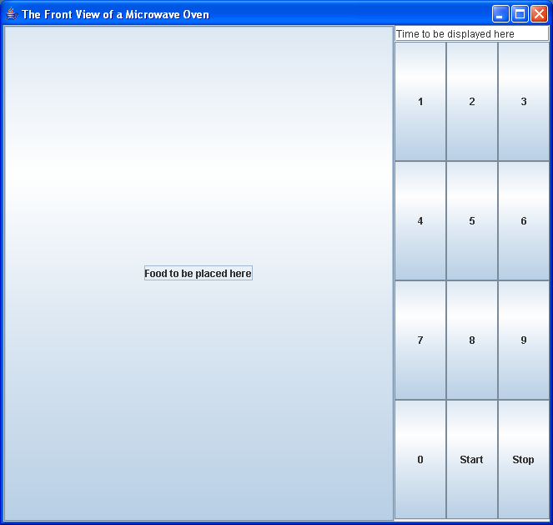
Button in the CENTER region
Panel p2 in the EAST region
Frame has BorderLayout manager

Slide 45
Text field in NORTH region
Panel p1 in the CENTER region
Panel p2 has BorderLayout manager

Slide 46
Panel p1 has GridLayout manager, four rows and three columns

Slide 47
Creating User Interfaces
Key Components

Slide 48
Motivations
A graphical user interface (GUI) makes a system user-friendly and easy to use. Creating a GUI requires creativity and knowledge of how GUI components work. Since the GUI components in Java are very flexible and versatile, you can create a wide assortment of useful user interfaces.
This section introduces the frequently used GUI components in detail.

Slide 49
Objectives
To create graphical user interfaces with various user-interface components: JButton, JCheckBox, JRadioButton, JLabel, JTextField, JTextArea, JComboBox, JList, JScrollBar, and JSlider.
To create listeners for various types of events.
To explore JButton
To explore JCheckBox
To explore JRadioButton
To explore JLabel
To explore JTextField
To explore JTextArea
To explore JComboBox
To explore JList
To explore JScrollBar
To explore JSlider

Slide 50
Components Covered
Introduces the frequently used GUI components
Uses borders and icons

Slide 51
Buttons
A button is a component that triggers an action event when clicked. Swing provides regular buttons, toggle buttons, check box buttons, and radio buttons. The common features of these buttons are generalized in javax.swing.AbstractButton.

Slide 52
AbstractButton

Slide 53
JButton
JButton inherits AbstractButton and provides several constructors to create buttons.

Slide 54
JButton Constructors
The following are JButton constructors:
JButton()
JButton(String text)
JButton(String text, Icon icon)
JButton(Icon icon)

Slide 55
JButton Properties
text
icon
mnemonic
horizontalAlignment
verticalAlignment
horizontalTextPosition
verticalTextPosition
iconTextGap

Slide 56

Default Icons, Pressed Icon, and Rollover Icon
A regular button has a default icon, pressed icon, and rollover icon. Normally, you use the default icon. All other icons are for special effects. A pressed icon is displayed when a button is pressed and a rollover icon is displayed when the mouse is over the button but not pressed.
(A) Default icon (B) Pressed icon (C) Rollover icon

Slide 57
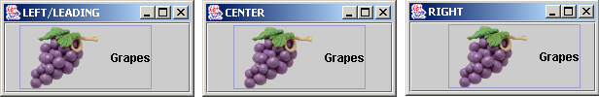
Horizontal Alignments
Horizontal alignment specifies how the icon and text are placed horizontally on a button. You can set the horizontal alignment using one of the five constants: LEADING, LEFT, CENTER, RIGHT, TRAILING. At present, LEADING and LEFT are the same and TRAILING and RIGHT are the same. Future implementation may distinguish them. The default horizontal alignment is SwingConstants.TRAILING.

Slide 58
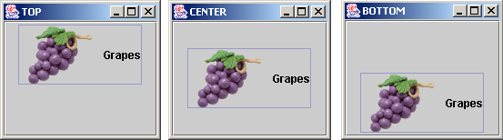
Vertical Alignments
Vertical alignment specifies how the icon and text are placed vertically on a button. You can set the vertical alignment using one of the three constants: TOP, CENTER, BOTTOM. The default vertical alignment is SwingConstants.CENTER.

Slide 59
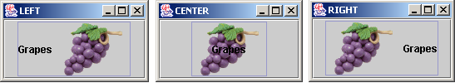
Horizontal Text Positions
Horizontal text position specifies the horizontal position of the text relative to the icon. You can set the horizontal text position using one of the five constants: LEADING, LEFT, CENTER, RIGHT, TRAILING. The default horizontal text position is SwingConstants.RIGHT.

Slide 60

Vertical Text Positions
Vertical text position specifies the vertical position of the text relative to the icon. You can set the vertical text position using one of the three constants: TOP, CENTER. The default vertical text position is SwingConstants.CENTER.

Slide 61
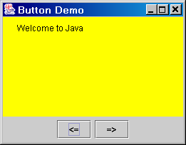
Example: Using Buttons
Write a program that displays a message on a panel and uses two buttons, <= and =>, to move the message on the panel to the left or right.
Run

Slide 62
JCheckBox
JCheckBox inherits all the properties such as text, icon, mnemonic, verticalAlignment, horizontalAlignment, horizontalTextPosition, verticalTextPosition, and selected from AbstractButton, and provides several constructors to create check boxes.

Slide 63
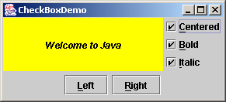
Example: Using Check Boxes
Add three check boxes named Centered, Bold, and Italic into the ButtonDemo example to let the user specify whether the message is centered, bold, or italic.
ButtonDemo
CheckBoxDemo

Slide 64
JRadioButton
Radio buttons are variations of check boxes. They are often used in the group, where only one button is checked at a time.

Slide 65
Grouping Radio Buttons
ButtonGroup btg = new ButtonGroup();
btg.add(jrb1);
btg.add(jrb2);

Slide 66
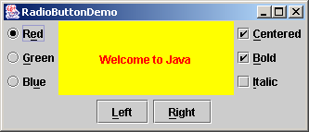
Example: Using Radio Buttons
Add three radio buttons named Red, Green, and Blue into the preceding example to let the user choose the color of the message.
ButtonDemo
CheckBoxDemo
RadioButtonDemo

Slide 67
JLabel
A label is a display area for a short text, an image, or both.

Slide 68
JLabel Constructors
The constructors for labels are as follows:
JLabel()
JLabel(String text, int horizontalAlignment)
JLabel(String text)
JLabel(Icon icon)
JLabel(Icon icon, int horizontalAlignment)
JLabel(String text, Icon icon, int horizontalAlignment)

Slide 69
JLabel Properties
JLabel inherits all the properties from JComponent and has many properties similar to the ones in JButton, such as text, icon, horizontalAlignment, verticalAlignment, horizontalTextPosition, verticalTextPosition, and iconTextGap.

Slide 70
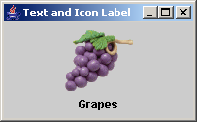
Using Labels
// Create an image icon from image file
ImageIcon icon = new ImageIcon("image/grapes.gif");
// Create a label with text, an icon,
// with centered horizontal alignment
JLabel jlbl = new JLabel("Grapes", icon, SwingConstants.CENTER);
// Set label's text alignment and gap between text and icon
jlbl.setHorizontalTextPosition(SwingConstants.CENTER);
jlbl.setVerticalTextPosition(SwingConstants.BOTTOM);
jlbl.setIconTextGap(5);

Slide 71
JTextField
A text field is an input area where the user can type in characters. Text fields are useful in that they enable the user to enter in variable data (such as a name or a description).

Slide 72
JTextField Constructors
JTextField(int columns)
Creates an empty text field with the specified number of columns.
JTextField(String text)
Creates a text field initialized with the specified text.
JTextField(String text, int columns)
Creates a text field initialized with the specified text and the column size.

Slide 73
JTextField Properties
text
horizontalAlignment
editable
columns

Slide 74
JTextField Methods
getText()
Returns the string from the text field.
setText(String text)
Puts the given string in the text field.
setEditable(boolean editable)
Enables or disables the text field to be edited. By default, editable is true.
setColumns(int)
Sets the number of columns in this text field. The length of the text field is changeable.

Slide 75
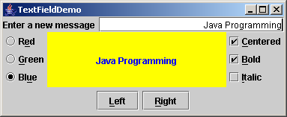
Example: Using Text Fields
Add a text field to the preceding example to let the user set a new message.

Slide 76
JTextArea
If you want to let the user enter multiple lines of text, you cannot use text fields unless you create several of them. The solution is to use JTextArea, which enables the user to enter multiple lines of text.

Slide 77
JTextArea Constructors
JTextArea(int rows, int columns)
Creates a text area with the specified number of rows and columns.
JTextArea(String s, int rows, int columns)
Creates a text area with the initial text and the number of rows and columns specified.

Slide 78
JTextArea Properties
text
editable
columns
lineWrap
wrapStyleWord
rows
lineCount
tabSize

Slide 79
Example: Using Text Areas
This example gives a program that displays an image in a label, a title in a label, and a text in a text area.

Slide 80
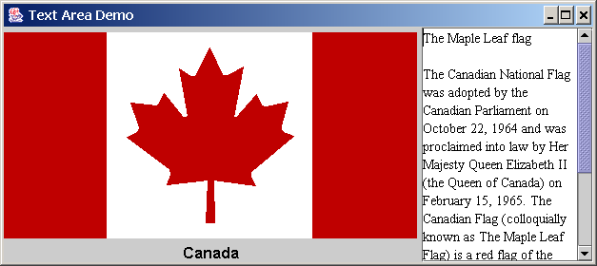
Example, cont.

Slide 81
JComboBox
A combo box is a simple list of items from which the user can choose. It performs basically the same function as a list, but can get only one value.

Slide 82
JComboBox Methods
To add an item to a JComboBox jcbo, use
jcbo.addItem(Object item)
To get an item from JComboBox jcbo, use
jcbo.getItem()

Slide 83
Using the itemStateChanged Handler
When a choice is checked or unchecked, itemStateChanged() for ItemEvent is invoked as well as the actionPerformed() handler for ActionEvent.
public void itemStateChanged(ItemEvent e) {
// Make sure the source is a combo box
if (e.getSource() instanceof JComboBox)
String s = (String)e.getItem();
}

Slide 84
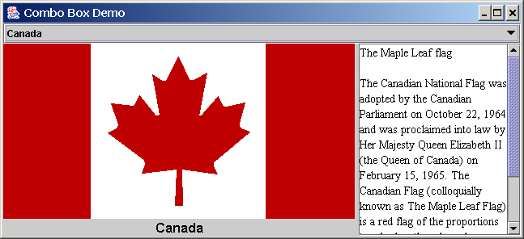
Example: Using Combo Boxes
This example lets users view an image and a description of a country's flag by selecting the country from a combo box.

Slide 85
JList
A list is a component that performs basically the same function as a combo box, but it enables the user to choose a single value or multiple values.

Slide 86
JList Constructors
JList()
Creates an empty list.
JList(Object[] stringItems)
Creates a new list initialized with items.

Slide 87
JList Properties
selectedIndexd
selectedIndices
selectedValue
selectedValues
selectionMode
visibleRowCount

Slide 88
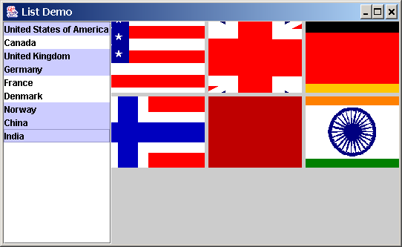
Example: Using Lists
This example gives a program that lets users select countries in a list and display the flags of the selected countries in the labels.

Slide 89
JScrollBar
A scroll bar is a control that enables the user to select from a range of values. The scrollbar appears in two styles: horizontal and vertical.

Slide 90
Scroll Bar Properties

Slide 91
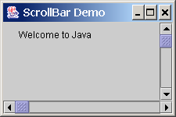
Example: Using Scrollbars
This example uses horizontal and vertical scrollbars to control a message displayed on a panel. The horizontal scrollbar is used to move the message to the left or the right, and the vertical scrollbar to move it up and down.

Slide 92
JSlider
JSlider is similar to JScrollBar, but JSlider has more properties and can appear in many forms.

Slide 93
Event-driven programming

Slide 94
Event-Driven Programming
Just like designing GUIs, you also will probably not write Java code like the program examples given in these notes. You will use IDEs like Netbeans, Eclipse JDT, Kdeveloper etc. to help you write event handling classes/methods/listeners in your GUIs. You must fill in the infrastructure that your preferred IDE provides you, of course. (An IDE can not know what to do when you press a button ☺)
Java codes given in these notes are for reference for understanding the underlying workings and design of event handling in Java.
Key Terms: event, event class, event source, event type, event listener class, listener interface, listener method (event handler)

Slide 95
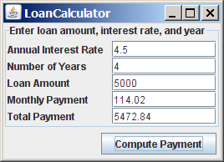
Motivations
Suppose you wish to write a GUI program that lets the user enter the loan amount, annual interest rate, and number of years, and click the Compute Loan button to obtain the monthly payment and total payment. How do you accomplish the task? You have to use event-driven programming to write the code to respond to the button-clicking event.

Slide 96
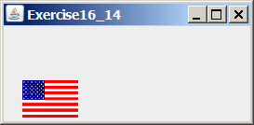
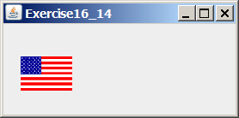
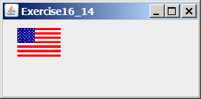
Motivations
Suppose you wish to write a program that animates a rising flag, as shown in the figure below. How do you accomplish the task? There are several solutions to this problem. An effective way to solve it is to use a timer in event-driven programming, which is the subject of this chapter.

Slide 97
Procedural vs. Event-Driven Programming
Procedural programming is executed in procedural order.
In event-driven programming, code is executed upon activation of events.

Slide 98
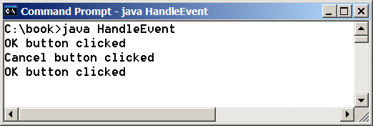
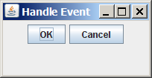
“Hello World!” of Event-Driven Programming
The example displays a button in the frame. A message is displayed on the console when a button is clicked.

Slide 99
Events
An event can be defined as a type of signal to the program that something has happened.
The event is generated by external user actions such as mouse movements, mouse clicks, and keystrokes, or by the operating system, such as a timer.

Slide 100
Event Classes

Slide 101
Event Information
An event object contains whatever properties are pertinent to the event. You can identify the source object of the event using the getSource() instance method in the EventObject class. The subclasses of EventObject deal with special types of events, such as button actions, window events, component events, mouse movements, and keystrokes. Following table lists external user actions, source objects, and event types generated.

Slide 102
Selected User Actions
Source Event Type User Action Object Generated
Click a button JButton ActionEvent
Click a check box JCheckBox ItemEvent, ActionEvent
Click a radio button JRadioButton ItemEvent, ActionEvent
Press return on a text field JTextField ActionEvent
Select a new item JComboBox ItemEvent, ActionEvent
Window opened, closed, etc. Window WindowEvent
Mouse pressed, released, etc. Component MouseEvent
Key released, pressed, etc. Component KeyEvent

Slide 103
The Delegation Model

Slide 104
Internal Function of a Source Component

Slide 105
The Delegation Model: Example
JButton jbt = new JButton("OK");
ActionListener listener = new OKListener();
jbt.addActionListener(listener);

Slide 106
Selected Event Handlers
Event Class Listener Interface Listener Methods (Handlers) ActionEvent ActionListener actionPerformed(ActionEvent)
ItemEvent ItemListener itemStateChanged(ItemEvent)
WindowEvent WindowListener windowClosing(WindowEvent)
windowOpened(WindowEvent)
windowIconified(WindowEvent)
windowDeiconified(WindowEvent)
windowClosed(WindowEvent)
windowActivated(WindowEvent)
windowDeactivated(WindowEvent)
ContainerEvent ContainerListener componentAdded(ContainerEvent)
componentRemoved(ContainerEvent) MouseEvent MouseListener mousePressed(MouseEvent)
mouseReleased(MouseEvent)
mouseClicked(MouseEvent)
mouseExited(MouseEvent)
mouseEntered(MouseEvent)
KeyEvent KeyListener keyPressed(KeyEvent)
keyReleased(KeyEvent)
keyTypeed(KeyEvent)

Slide 107
java.awt.event.ActionEvent

Slide 108
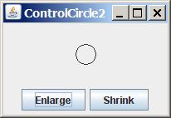
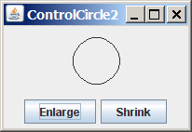
Example: First Version for ControlCircle (no listeners)
Now let us consider to write a program that uses two buttons to control the size of a circle.

Slide 109
Example: Second Version for ControlCircle (with listener for Enlarge)
Now let us consider to write a program that uses two buttons to control the size of a circle.

Slide 110
Inner Class Listeners
A listener class is designed specifically to create a listener object for a GUI component (e.g., a button). It will not be shared by other applications. So, it is appropriate to define the listener class inside the frame class as an inner class.

Slide 111
Inner Classes
Inner class: A class is a member of another class.
Advantages: In some applications, you can use an inner class to make programs simple.
An inner class can reference the data and methods defined in the outer class in which it nests, so you do not need to pass the reference of the outer class to the constructor of the inner class.

Slide 112
Inner Classes, cont.

Slide 113
Inner Classes (cont.)
Inner classes can make programs simple and concise.
An inner class supports the work of its containing outer class and is compiled into a class named OuterClassName$InnerClassName.class. For example, the inner class InnerClass in OuterClass is compiled into OuterClass$InnerClass.class.

Slide 114
Inner Classes (cont.)
An inner class can be declared public, protected, or private subject to the same visibility rules applied to a member of the class.
An inner class can be declared static. A static inner class can be accessed using the outer class name. A static inner class cannot access nonstatic members of the outer class

Slide 115
Anonymous Inner Classes
An anonymous inner class must always extend a superclass or implement an interface, but it cannot have an explicit extends or implements clause.
An anonymous inner class must implement all the abstract methods in the superclass or in the interface.
An anonymous inner class always uses the no-arg constructor from its superclass to create an instance. If an anonymous inner class implements an interface, the constructor is Object().
An anonymous inner class is compiled into a class named OuterClassName$n.class. For example, if the outer class Test has two anonymous inner classes, these two classes are compiled into Test$1.class and Test$2.class.

Slide 116
Anonymous Inner Classes (cont.)
Inner class listeners can be shortened using anonymous inner classes. An anonymous inner class is an inner class without a name. It combines declaring an inner class and creating an instance of the class in one step. An anonymous inner class is declared as follows:
new SuperClassName/InterfaceName() {
// Implement or override methods in superclass or interface
// Other methods if necessary
}

Slide 117
Alternative Ways of Defining Listener Classes
There are many other ways to define the listener classes. For example, you may rewrite previous program by creating just one listener, register the listener with the buttons, and let the listener detect the event source, i.e., which button fires the event.

Slide 118
Alternative Ways of Defining Listener Classes
You may also define the custom frame class that implements ActionListener.

Slide 119
Problem: Loan Calculator

Slide 120
Example: Handling Window Events
Objective: Demonstrate handling the window events. Any subclass of the Window class can generate the following window events: window opened, closing, closed, activated, deactivated, iconified, and deiconified. This program creates a frame, listens to the window events, and displays a message to indicate the occurring event.

Slide 121
MouseEvent

Slide 122
Handling Mouse Events
Java provides two listener interfaces, MouseListener and MouseMotionListener, to handle mouse events.
The MouseListener listens for actions such as when the mouse is pressed, released, entered, exited, or clicked.
The MouseMotionListener listens for actions such as dragging or moving the mouse.

Slide 123
Handling Mouse Events

Slide 124
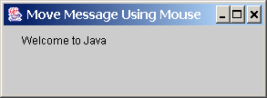
Example: Moving Message Using Mouse
Objective: Create a program to display a message in a panel. You can use the mouse to move the message. The message moves as the mouse drags and is always displayed at the mouse point.

Slide 125
Handling Keyboard Events
To process a keyboard event, use the following handlers in the KeyListener interface:
keyPressed(KeyEvent e)
Called when a key is pressed.
keyReleased(KeyEvent e)
Called when a key is released.
keyTyped(KeyEvent e)
Called when a key is pressed and then released.

Slide 126
The KeyEvent Class
Methods:
getKeyChar() method
getKeyCode() method
Keys:
Home VK_HOME
End VK_END
Page Up VK_PGUP
Page Down VK_PGDN
etc...

Slide 127
The KeyEvent Class, cont.

Slide 128
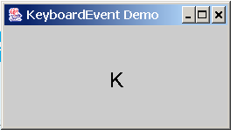
Example: Keyboard Events Demo
Objective: Display a user-input character. The user can also move the character up, down, left, and right using the arrow keys.

